Slide 1

The National Water Census Implementation Plan Why should we write it?
U.S. Department of the Interior
U.S. Geological Survey
Notes:
Good Morning!
I would like to provide you today with an update of the USGS activities on the WaterSMART Initiative – part of our overall strategy to produce a Nation Water Census. The image on the right is our report to Congress, which was delivered in March, 2013, and is available from the url on the screen.

Slide 2
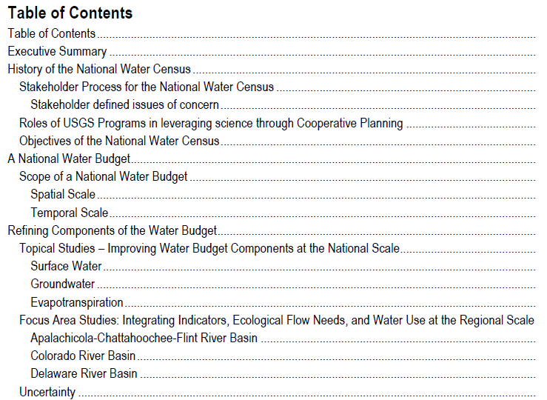
Notes:
Emphasize this objective and the questions to be answered. We are founded in the SECRUE Water Act, which was passed in 2009. Section 9508 is essentially a blueprint for the Water Census – a national assessment of water availability and use.

Slide 3
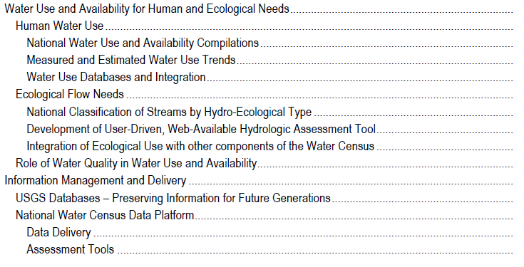
Notes:
Emphasize this objective and the questions to be answered. We are founded in the SECRUE Water Act, which was passed in 2009. Section 9508 is essentially a blueprint for the Water Census – a national assessment of water availability and use.

Slide 4
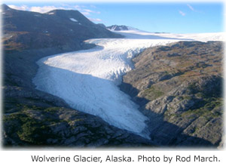
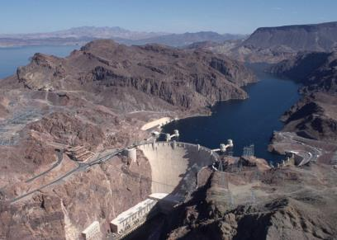
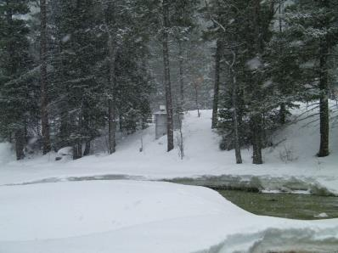
Water in Storage
Glaciers
Reservoirs
Snow

Slide 5
Water in Storage
What is the fractional contribution of snow to the annual water budget?
How much snowfall ends up in streams and rivers and how much is lost to sublimation, evapotranspiration, and subsurface storage?
Can models and/or remotely sensed data be used to accurately estimate snow water content and to simulate snowpack processes across the landscape?
How can observations help guide development of snowpack models and remote sensing techniques, and what temporal and spatial resolution is required for those observations?
How do the dynamics of snow accumulation and snowmelt change in response to changing climate conditions?
Snow

Slide 6
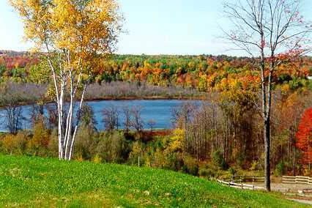
Reservoirs
Understand the capacity of these?
How about the capacity of these?
Is there a role for
remote sensing?

Slide 7
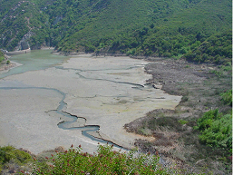
Reservoirs
Reservoir Sedimentation related to capacity? The role of RESSED.

Slide 8
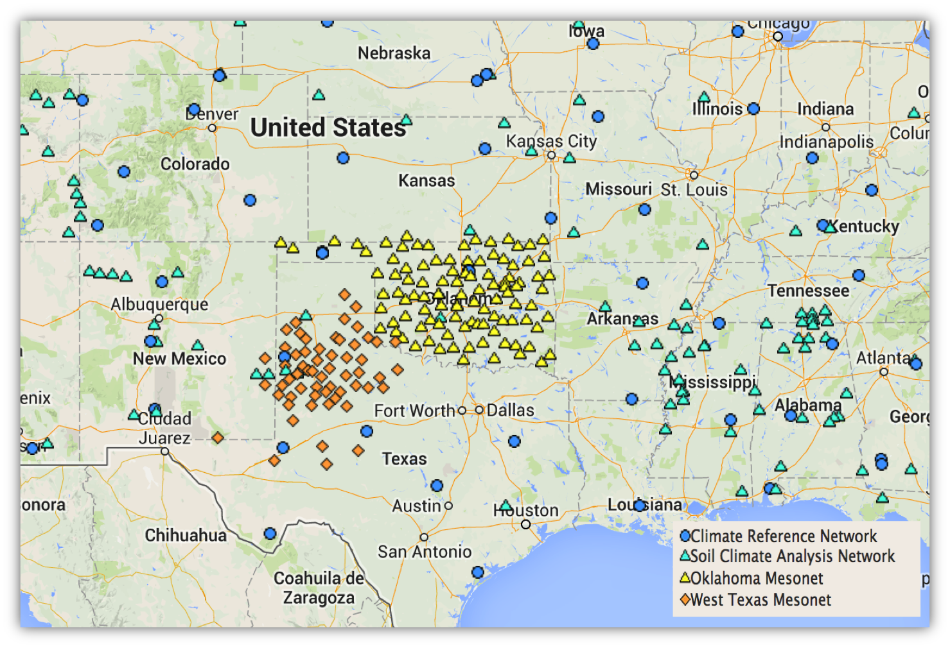
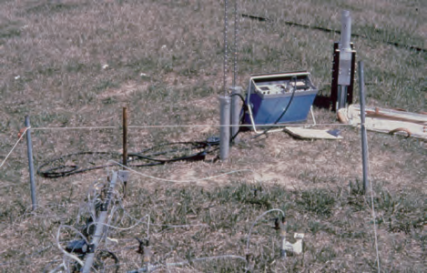
Soil Moisture
Development of a Pilot National Soil Moisture Network
Jennifer Lucido, CIDA and Steven Quiring TAMU
The NSMN Pilot will provide users with a number of options for visualizing and mapping soil moisture conditions.

Slide 9
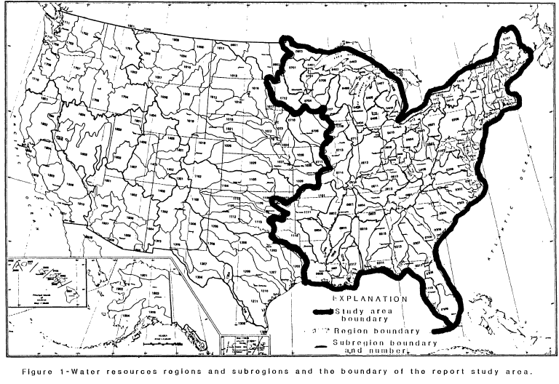
Where are we going in the Future ?
Interbasin Transfers at HUC-8 Level
Inventory of Interbasin Transfers of Water in the Eastern Region United States, 1986;
OFR 86-148

Slide 10
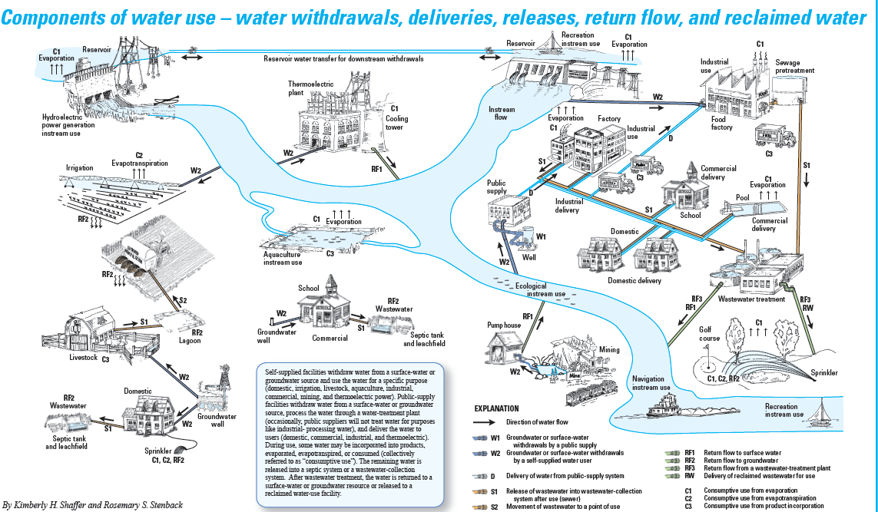
Where are we going in the Future ?
Water Tracking
Linking PWSS and WWTP

Slide 11
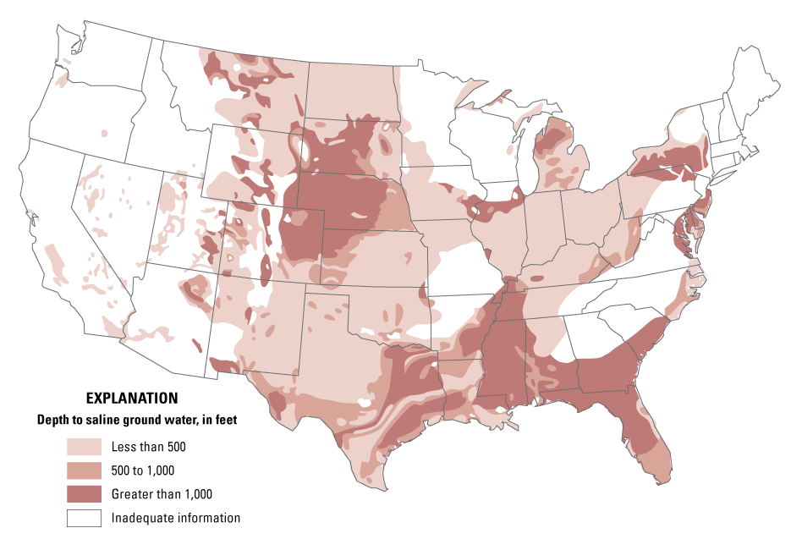
Assess the Nation’s Brackish Resources
Continue and strengthen the effort begun under the Challenge Projects RFP for 2010
Locations of the res.
Hydrologic properties
Water quality properties
Current uses
Notes:
We will use some of the resources of this initiative to continue and complete an analysis of the Nation’s brackish aquifer systems. This analysis is a priority under the SECURE Water Act and the USGS began this effort in 2010 with the initiation of three regional studies on brackish aquifers. The initiative will give us the ability to double our efforts in this area.

Slide 12
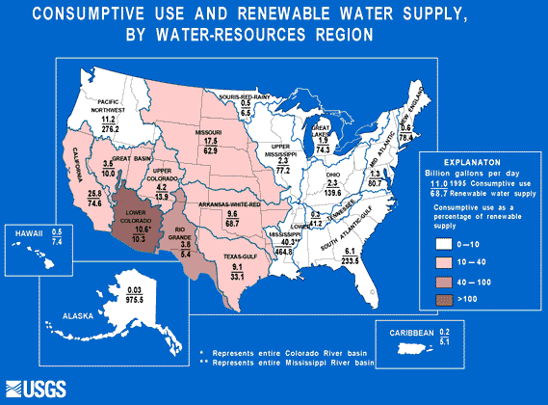
Notes:
Comparisons of average consumptive use and renewable water supply for the 21 water-resources regions of the United States, Puerto Rico, and U.S. Virgin Islands
(U.S. Geological Survey, 1984; updated using 1995 estimates of water use)
The renewable water supply is the sum of precipitation and imports of water, minus the water not available for use through natural evapotranspiration and exports. Renewable water supply is a simplified upper limit to the amount of water consumption that could occur in a region on a sustained basis. Requirements to maintain minimum flows in streams leaving the region for navigation, hydropower, fish, and other instream uses limit the amount of the renewable supply available for use. Also, total development of a surface-water supply is never possible because of increasing evaporative losses as more reservoirs are used. Nevertheless, the renewable supply compared to consumptive use is an index of the degree to which the resource has already been developed.
Reference: U.S. Geological Survey, 1984, National Water Summary 1983-Hydrologic events and issues: U.S. Geological Survey Water-Supply Paper 2250.

Slide 13
National Report Products
Measures of Water Stress – Examples:
Consumptive and Depletive Use as a Percentage of Total Precipitation plus Imports minus Evapotransporation.
Consumptive and Depletive Use related to measures of Streamflow Variability.
Interbasin Transfers as a percentage of total flow related to measures of Streamflow Variability.
National Characterization of Groundwater Divides and how they have moved.

